Slide 1
History of Debt in Modern U.S Recessions

Slide 2
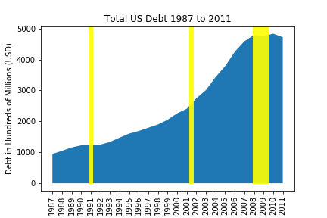

Slide 3
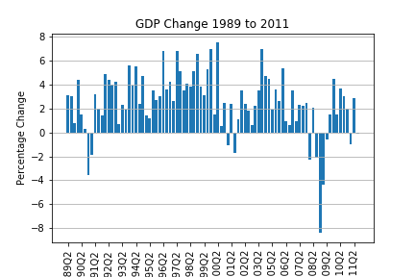

Slide 4
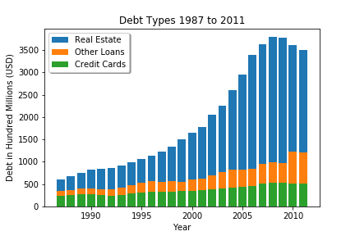

Slide 5
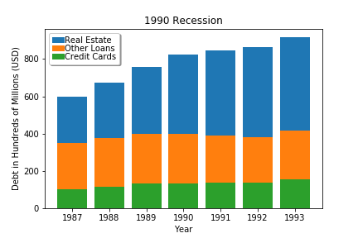

Slide 6
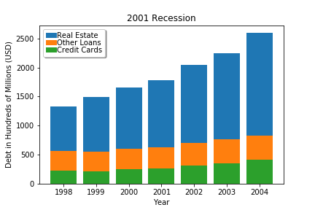

Slide 7
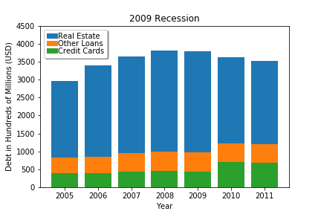

Slide 8
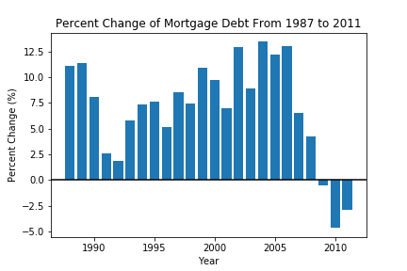

Slide 9
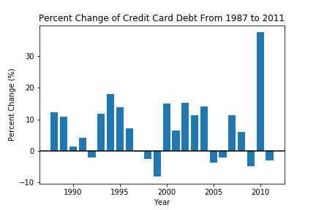

Slide 10
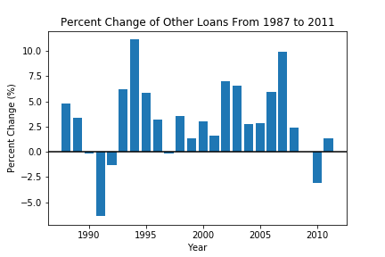

Slide 11
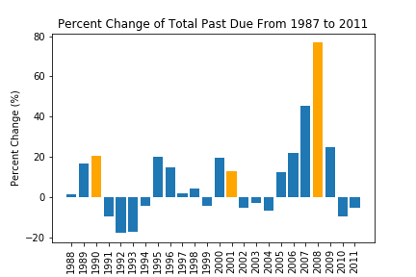

Slide 12
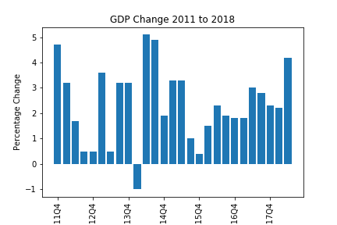

Slide 13
Mortgage Debt / GDP
statistic=6.031691081884235,
pvalue=4.526441776962849e-06
Total Past Due / GDP
statistic=6.031691081884235,
pvalue=4.526441776962849e-06
Credit Card Debt / GDP
statistic=8.470965264663457,
pvalue=2.254579831403231e-08
Other Loans(unsecured debt)/GDP
Ttest_indResult(statistic=17.68729772930171, pvalue=1.7089141619365364e-14)
Total Loans/GDP
Ttest_indResult(statistic=8.833348246407603, pvalue=1.0966513760407545e-08
ANOVA - Total Loans, Total Past Due / GDP
statistic=75.41560450198821,
pvalue=8.972857246567078e-18
ANOVA – Real Estate, Total Past Due / GDP
statistic=61.25206721078445,
pvalue=9.106695912165343e-16
Regression Model Score GDP/Total Past Due Debt:
0.4170358214450272

Slide 14
 | coef | std err | t | P>|t| | [0.025 | 0.975]
Intercept | 0.9273 | 3.426 | 0.271 | 0.790 | -6.269 | 8.124
ttl_loan | -5.031e-09 | 4.13e-08 | -0.122 | 0.904 | -9.19e-08 | 8.18e-08
ttl_past | -2.953e-08 | 7.32e-09 | -4.033 | 0.001 | -4.49e-08 | -1.41e-08
real_estate | 3.277e-09 | 4.26e-08 | 0.077 | 0.939 | -8.62e-08 | 9.27e-08
credit_card | 1.603e-08 | 4.28e-08 | 0.374 | 0.713 | -7.4e-08 | 1.06e-07
other_loans | 1.659e-08 | 2.47e-08 | 0.671 | 0.511 | -3.54e-08 | 6.86e-08

